Slide 1
DarysDale AI
Mary Girgis

Slide 2
Product Main Idea Description
Data Extraction Software : The most basic types of data extraction software are related to the scanning and conversion of data present in PDF files, handwritten documents, images, etc., into digitally usable forms using Optical Character Recognition(OCR)
OCR :It became simple to extract and store information from multiple files and sources, reducing industries' manual efforts. It also provides a complete form processing and document capture solution, such as passport documents, invoices, bank statements, receipts, business cards, mail, or any number of printed records.
Applications of Intelligent Data Extraction in Different Industries
Banking Industry
Accounting and Taxation
Supply Chain Management
Legal Service Providers
Financial Services
Healthcare and Life Science
Public Sector
Students
Notes:
https://www.verifiedmarketresearch.com/product/optical-character-recognition-ocr-systems-market/
https://www.klearstack.com/intelligent-data-extraction-invoice/
https://www.klearstack.com/data-extraction-software-extract-more-than-text/

Slide 3
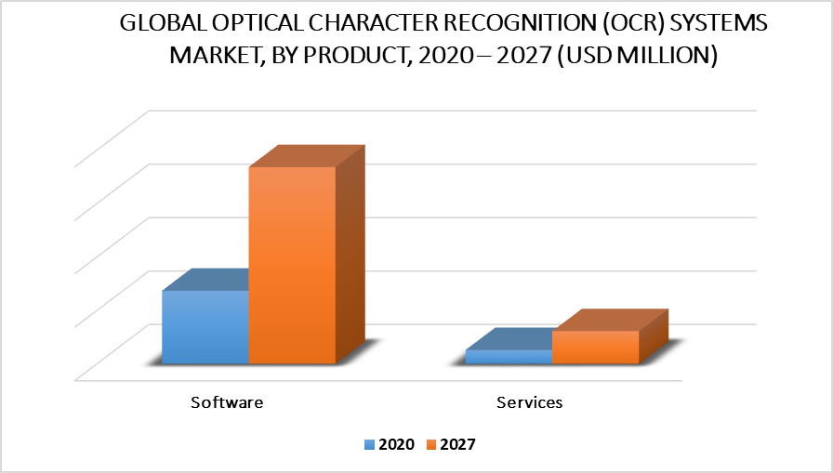
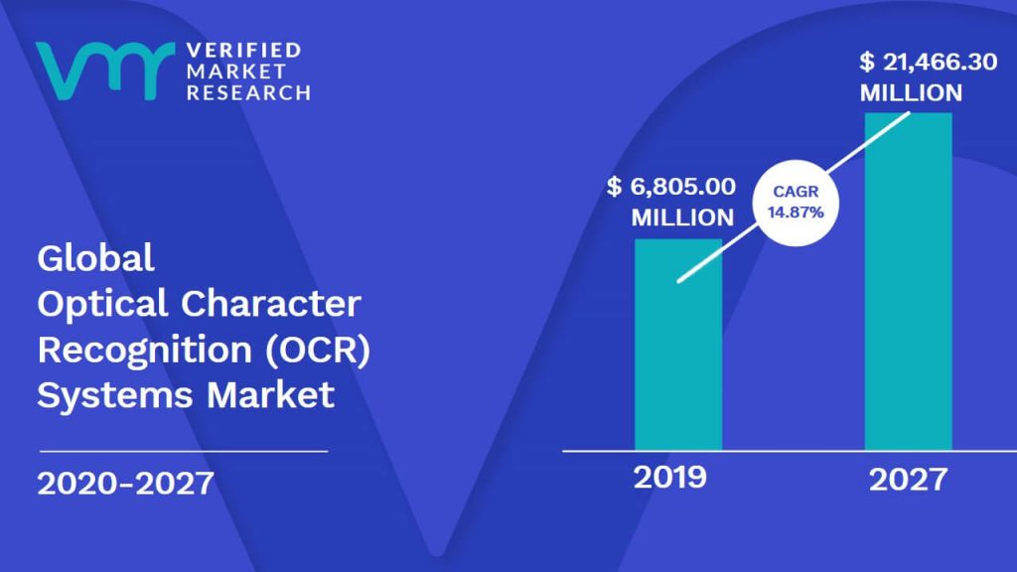
Market Size
Notes:
https://www.verifiedmarketresearch.com/product/optical-character-recognition-ocr-systems-market/

Slide 4
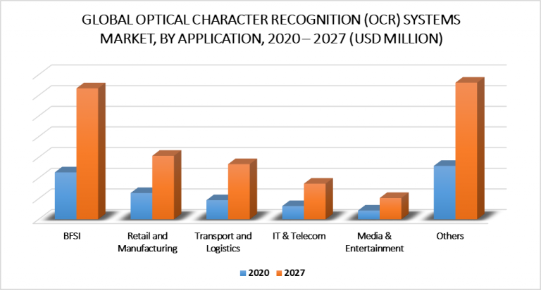
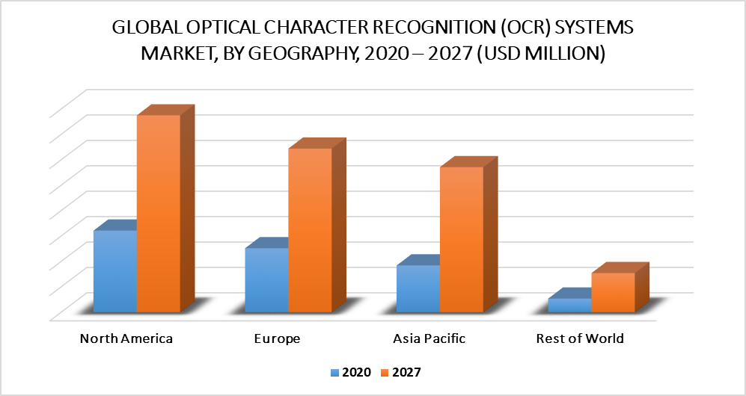
Global OCR Systems Market by Application
Notes:
https://www.verifiedmarketresearch.com/product/optical-character-recognition-ocr-systems-market/

Slide 5

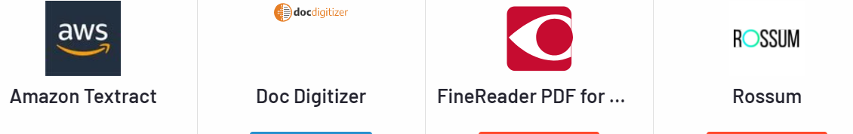

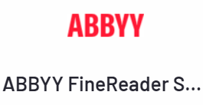
Competitors
Notes:
https://www.g2.com/compare/amazon-textract-vs-doc-digitizer-vs-finereader-pdf-for-windows-and-mac-vs-rossum
https://www.g2.com/compare/docparser-vs-ibm-datacap-vs-kofax-capture-vs-laserfiche

Slide 6
Product Vision
For Public sectors, financial services, healthcare, and life science, banking industry, management
Who want to Digitize documents scans with OCR, Extracts text and data from scanned Doc, Images, CSV, XML
Our product is an AI-powered service is for delivering best-in-class AI data-processing solutions
That provides extract text and data from scanned documents automatically, and support Arabic OCR
Unlike other doc parsers using OCR
Our product will be
Digitize documents and scans with OCR
Extracts text and data from scanned Doc,Images, CSV, XML
Available on all major platforms
Precise searching(OCR)
Third-Party Integrations
Document Classification, Extraction, and Management
Up to 98% accuracy
Streamline processes
Support Arabic OCR

Slide 7
SWOT
Strengths
Weaknesses
Plenty of great features
Extract and read most of extension types
Digitize documents and scans with OCR
Third-Party Integrations
Available on all major platforms
Online Customer Support
Limited doc parsers
Security & privacy
Reputation management
Industry presence
SWOT
Threats
Opportunities
Differentiation and Innovation
Market Segment
Runs on Cloud, On Prem
Precise searching(OCR)
Support Arabic (OCR )
Aggressive competition
Reputation
Customer Service Support
User Experience
Notes:
Strength:
Plenty of great features
Low cost structure
Extract and read the incoming invoices, product catalogues ,PDF
Read and Extract PDF, JPG, PNG,Doc,csv
Third-Party Integrations
Available on all major platforms
Digitize documents and scans with OCR
Weakness
Limited doc parsers
Security & privacy
Reputation management
Industry presence
Opportunity
Differentiation and Innovation
Market Segment
Runs on Cloud, OnPrem
Precise searching(OCR)
Threats
Aggressive competition
Reputation
Customer Service Support
User Experience

Slide 8
Challenges/Problems
Goals :
Ability to digitize documents and extract information at a lower cost using an AI-data processing solution.
Performing precise searching (OCR) with the ability of Third-Party Integrations
Document classification, extraction, and management.
Employs self-learning neural networks to mimic how a human searches for information in a document.
Support Arabic OCR
Risks :
Aggressive competition
Build good Reputation
Customer Service Support
User Experience
Searching time
Level of Searching Accuracy

Slide 9





VISION
AI-powered service is for delivering best-in-class AI data-processing solutions that extract text and data from scanned documents automatically.
It goes beyond simple optical character recognition (OCR) to identify the contents of form fields and data stored in tables.
What is your purpose for creating the product?
Which positive change should it bring about?
TARGET GROUP
NEEDS
PRODUCT
BUSINESS GOALS
Which market or market segment does the product address?
Who are the target customers and users?
What problem does the product solve?
Which benefit does it provide?
What product is it?
What makes it stand out?
Is it feasible to develop the product?
How is the product going to benefit the company?
What are the business goals?
Easy to user
Third-Party Integrations
Available on all major platforms
Digitize documents and scans with OCR
Extract and read the incoming invoices, product catalogues ,PDF
Read and Extract PDF, JPG, PNG,Doc,csv
Precise searching(OCR)
Doc parsers
Digitize documents and scans with OCR
Extracts text and data from scanned Doc,Images, CSV, XML
All major platforms are supported.
Precise searching(OCR)
Third-Party Integrations
Document Classification, Extraction, and Management
Support Arabic OCR
Banking Industry
Accounting and Taxation
Supply Chain Management
Legal Service Providers
Financial Services
Healthcare and Life Science
Public Sector
Students
Up to 98% accuracy
Streamline processes
Data usability and conversion
Saving Time
Easy Access
Reduce costs associated with manual data entry

Slide 10
Proposed Business Model Canvas
Partners | Key Activities | Values Propositions | Customer Relationships | Customer Segments
 | Software Development Integration It Maintenance Marketing Product Roadmap Features updates Customer Support service
Development Team Third party integration Students Financial sectors Generic user Healthcare sector |  | Easy to user Third-Party Integrations Available on all major platforms Digitize documents and scans with OCR Extract and read the incoming invoices, product catalogues ,PDF Read and Extract PDF, JPG, PNG,Doc,csv Precise searching(OCR) Doc parsers Up to 98% accuracy Streamline processes Support Arabic OCR | Tech support / Forms / Q & A sections / Integrations / Text Extract / Third-party integration | Financial Services Healthcare and Life Science Public Sector Developers Students
 | Resources |  | Channels
 | Developers / Platform / integrations /Cross-platform |  | Marketplace/ API/ web platform /SDK/technical blogs Search Engine optimization/ Youtube
Costs | Development team /Maintenance /support / Marketing /Taxes Customer Development research |  | Revenues | Freemium business Model starting with 30 days free trial free trial(0$) /standard (25$)/Professional (60$)/Business(125$)

Slide 11
Proposed Business Strategy
Mission:
Digitize documents and Extracts text and data from different documents formats
Vision:
We will be providing AI data-processing solutions that use OCR to automatically extract text and data from scanned documents.
Values:
Market segments,Usability, Customer service ,Performance and Pricing strategy
Competitive Advantage:
Ability to digitize documents ,extract information using AI-data processing solution at a lower cost.
Strategic Objectives:
Market segmentation,Product market fit and deliver the value customers expect from Doc parsers application .
Short-term goals:
Meet customer's requirement, Precise searching (OCR), Up to 98 percent accuracy, and Streamlined processes for digitizing documents and extracting information

Slide 12
Hypothesis
We believe that Data Extraction Software will enable industries to extract and store information from multiple files and sources, reducing manual efforts. It also provides a complete form processing and document capture solution, such as passport documents, invoices, bank statements, receipts, business cards, mail, or any number of printed records. utilizing Optical Character Recognition (OCR)
for Banking Industry, Accounting and Taxation, Supply Chain Management, Legal Service Providers, Financial Services, Healthcare, and Life Science, Public Sector, Students
We will OCR-digitize documents and scans, extract text and data from scanned Docs, Images, CSV, XML, Support Arabic document,and be available on all platforms, in addition to performing precise searching (OCR) with the ability of Third-Party Integrations. Aside from document classification, extraction, and management.

Slide 13
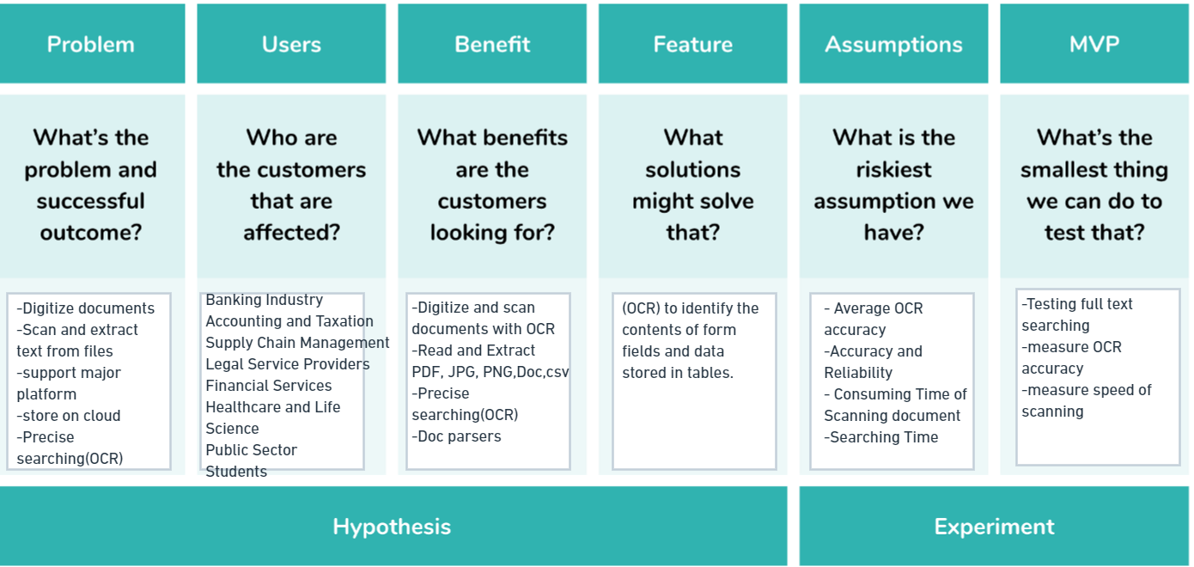

Slide 14
Hypothesis Validation (Using Survey)
To validate the hypotheses, we conducted a user survey.
Key Survey objectives were to identify:
How interested would you be in purchasing DarysDale AI for Data Extraction ?
How important are the following features of the proposed new product?
What are the product features that make you more or less interested in purchasing?
What would you expect to pay for this product if it had all of the above attributes?
What do you currently use as an alternative to our proposed product?
Which payment method do you prefer?
Please provide any additional comments about our proposed product.
Survey used available: Link

Slide 15
Solution
Solution based on artificial intelligence elements that can automatically retrieve document information
Using self-learning neural networks to mimic how a person searches for information in a document.
Providing the ability to retrieve data without configuring it and learn from examples since the first processed
Performing precise searching (OCR)
The ability of Third-Party Integrations.
Possibility of Document classification, extraction, and management.
1
2
3
4
5
6
Generate Ideas
Researching & idea validation
Develop MVP
Testing
Product Development
Launch

Slide 16

Why DarysDale AI Beats Competitors
Features | DarysDale Al | Competitors
Receive documents via dozens of different channels
Available in all platforms
Precise searching(OCR) & Support Arabic OCR
Document Classification, Extraction, and Management
Online Customer Support Service
Up to 98% accuracy

Slide 17
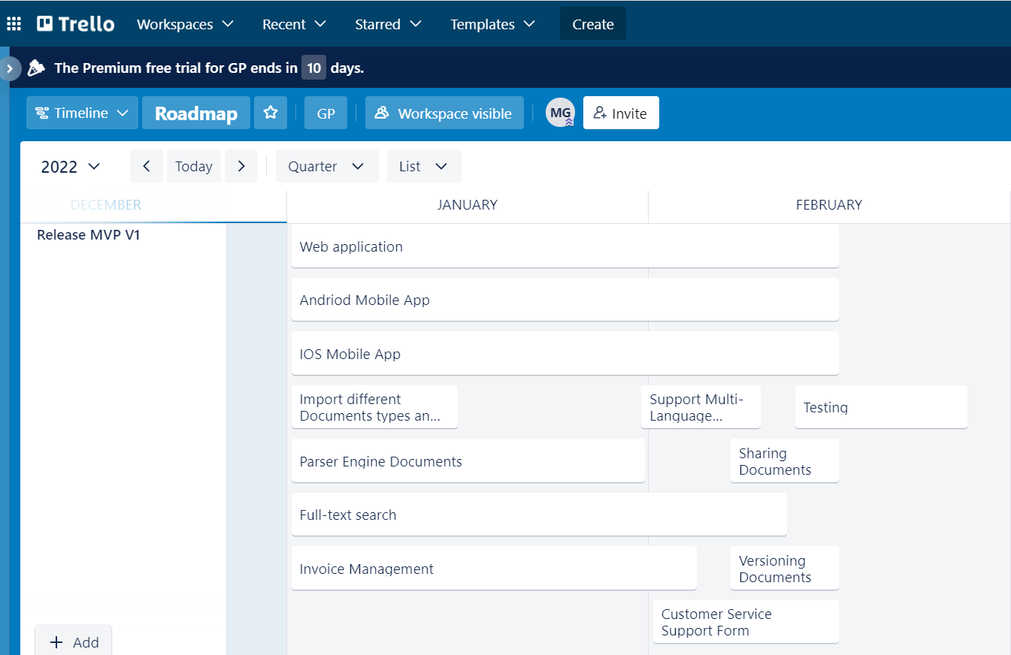
Release MVP V1
MVP V1 (Jan-Feb 2022)
Web application
Android Mobile App
IOS Mobile App
Import different document types & schema
Parser Engine Documents
Full-text Search
Invoice Management
Support Multi-Language
Sharing Documents
Versioning Documents
Customer Service Support Form (offline)
Testing
Notes:
https://trello.com/b/mgFwbA0O/roadmap/timeline

Slide 18
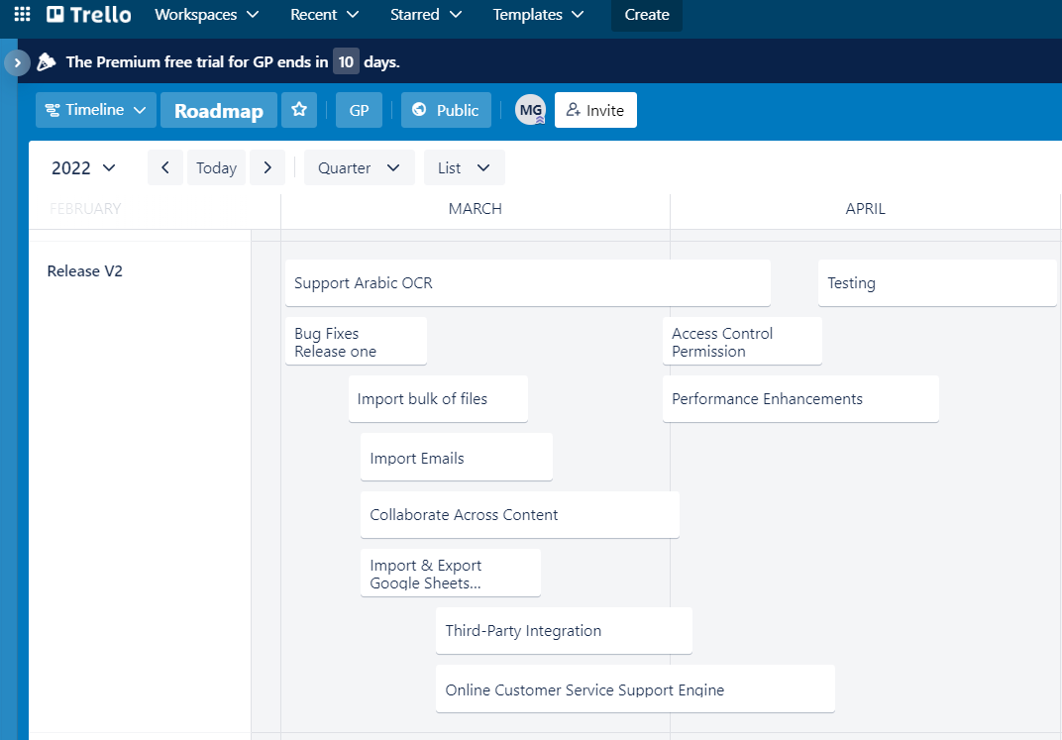
Release V2
Release V2 (Mar-Apr 2022)
Support Arabic OCR
Bug fixes release one
Import bulk of files
Import emails
Access control permission
Collaborate across content
Third-Party integration
Import & export google sheets
Online customer service support engine
Performance enhancements
Testing
Notes:
https://trello.com/b/mgFwbA0O/roadmap/timeline

Slide 19
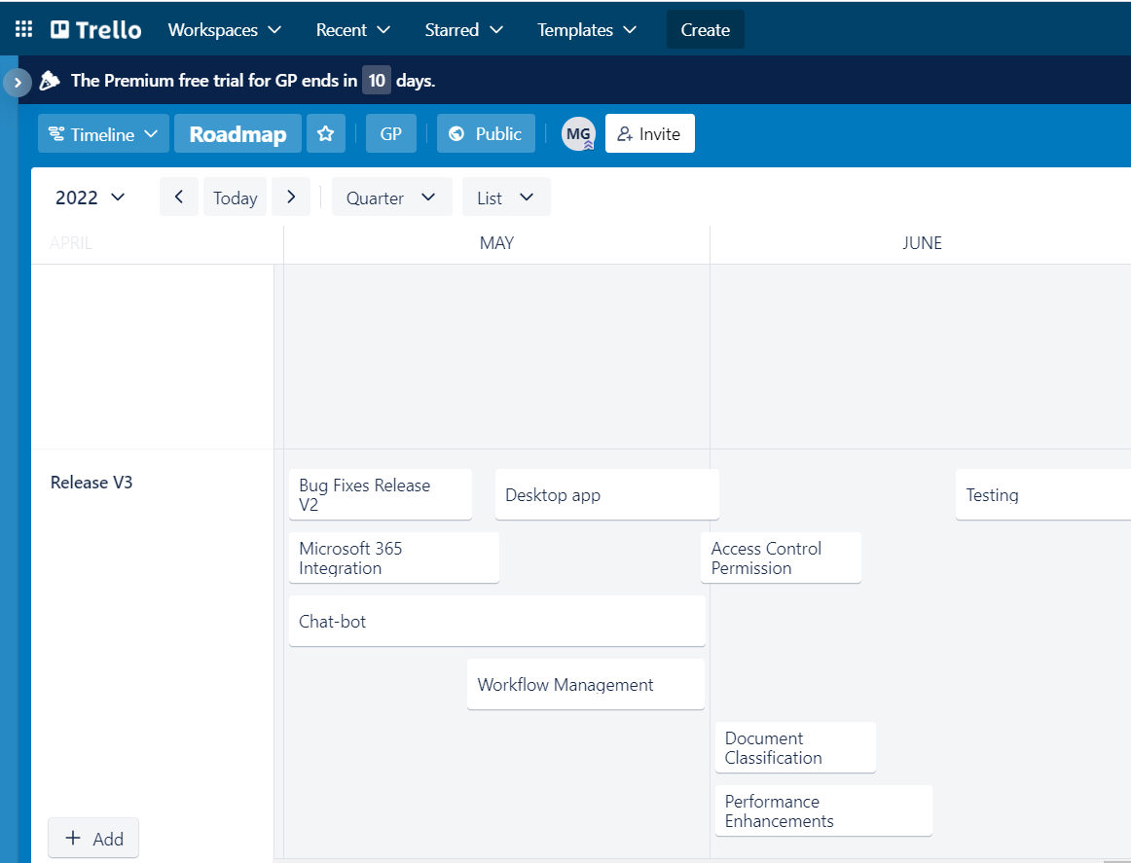
Release V3
Release V3 (May-June 2022)
Bug Fixes Release V2
Desktop App
Microsoft 365 integration
Chat-bot
Access control Permission
Workflow Management
Document Classification
Performance enhancements
Testing
Notes:
https://trello.com/b/mgFwbA0O/roadmap/timeline

Slide 20
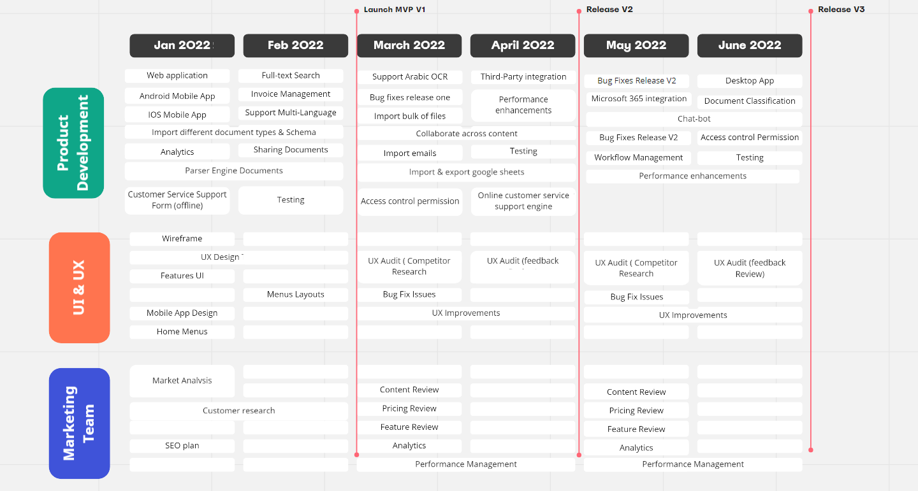
Product Roadmap
https://miro.com/app/board/uXjVOb4eyUM=/?invite_link_id=644907957951
Notes:
https://miro.com/app/board/uXjVOb4eyUM=/?invite_link_id=644907957951

Slide 21
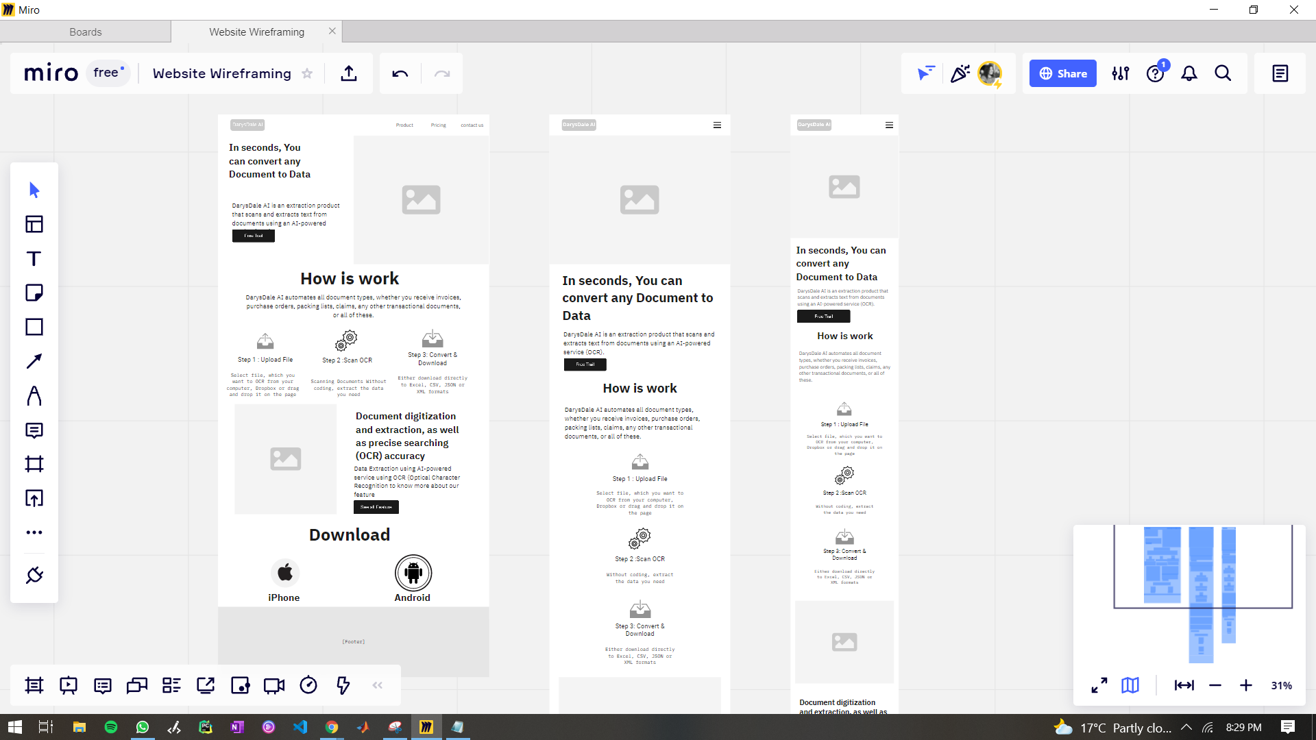
Product MVP
https://miro.com/app/board/uXjVObbrDL0=/?invite_link_id=857892818352
Notes:
Web Wireframe https://miro.com/app/board/uXjVObbrDL0=/?invite_link_id=857892818352

Slide 22
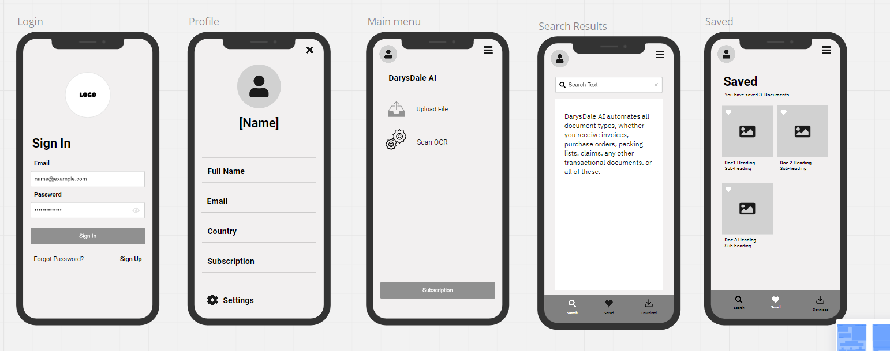
Product MVP
https://miro.com/app/board/uXjVObbrDL0=/?invite_link_id=857892818352
Notes:
Mobile Wireframe https://miro.com/app/board/uXjVObbrDL0=/?invite_link_id=857892818352

Slide 23
Metrics
Business metrics:it is important to understand how you are attracting, converting, and retaining paid customers.
Churn Rate
Monthly Customer retention
Product usage metrics :Understanding how people are actually using your product demonstrate product health and engagement
Daily active users (DAU) or monthly active users (MAU)
Feature usage
Customer behavior metrics : Validating as hearing your customers rave about your product. If you want to achieve long-term success, you need to earn real love and loyalty from customers
Customer Acquisition Cost (CAC)
Existing Customer Growth Rate
Customer Lifetime Value (CLV)
Loyal Customer Rate
Net Promoter Score (NPS)
Customer Satisfaction Score (CSAT)
Customer Churn
Revenue Churn
Notes:
https://www.aha.io/roadmapping/guide/product-strategy/product-metrics
Business metrics: it is important to understand how you are attracting, converting, and retaining paid customers. Consider tracking the following business and marketing metrics
Conversion rate to trial account: Rate at which website visitors sign up for a free product trial.
Conversion rate to paid account: Rate at which trial users convert to a paid account.
Customer acquisition cost (CAC): Average cost associated with capturing a new customer.
Customer lifetime value (LTV): Average revenue from customers over the life of the relationship.
Monthly recurring revenue (MRR): Recurring revenue at the end of a given month — including new and existing customers.
Website visitors: Number of unique and repeat visitors to your website each month.
Churn: Percentage of customers that you lose during a certain time period, typically calculated monthly and annually.
Monthlly Customer retention: is usually presented as a percentage that measures how many customers a company keeps at the end of a set time period.
Product usage metrics : Understanding how people are actually using your product demonstrate product health and engagement
Daily active users (DAU) or monthly active users (MAU): Number of customers who use your product on a daily or monthly basis.
Feature usage: Number or percentage of customers who use a certain feature or set of features
Customer satisfaction metrics : validating as hearing your customers rave about your product. If you want to achieve long-term success, you need to earn real love and loyalty from customers
Customer satisfaction score (CSAT): Rating of satisfaction with a product or company on a one to five scale (determined by a customer survey).
Net promoter score (NPS): Likelihood of your customers recommending your product or company to others (determined by a customer survey).
Retention: Rate at which customers keep and renew their accounts.
Viral coefficient: Average conversion rate of new customers invited by an existing customer.
Roadmap progress metrics :In addition to metrics based on user actions, product managers need to evaluate work in progress to meet deadlines.
Features shipped: Number of new features released to customers in a given time period.
Sprint burndown: How the team is progressing towards completing all planned work in a sprint.
Velocity: Rate of progress or average amount of work completed in a given sprint or time frame.
Work-in-progress: Current features and tasks that are actively being worked on
Product Analytics :
Retention analysis: Understanding the factors that entice your customers to stay (the inverse of churn analysis).
Segmentation: Dividing your users into groups based on demographics, behavior, persona, and more to uncover deeper insights.
Important Customer Retention Metrics :
Customer churn is one of the most straightforward customer retention metrics. The churn rate refers to the rate at which clients stop interacting with your business. They may have opted out of renewing their subscription with your brand or just stopped buying from you.
Revenue churn rate:Your revenue churn rate refers to the percentage of revenue lost from existing customers within a specific period.
Existing customer revenue growth rate
Repeat purchase ratio: The repeat purchase ratio or RPR is the percentage of customers in your community that has returned to purchase something from your company againThis is an excellent indicator of customer loyalty – which is important to the overall customer retention rate that you build over time. You can apply this metric to things other than product purchases too
Net promoter scoreNet promoter score (NPS) is probably one of the best-known metrics for customer retention and customer loyalty. This quantitatively measures the general satisfaction and loyalty that people feel to your brand.
https://www.ringcentral.co.uk/gb/en/blog/customer-loyalty-innovative-customer-retention-strategies/
Note : You can also compare your NPS to your revenue growth rate and customer churn rate to predict potential growth for your business.

Slide 24
Go To Market Plan & Strategy
1
Target Market
Financial Sectors Healthcare and Life Science Public Sector
Students
2
Strategic Partnership /channel
Marketplace/ API/ web platform /SDK/technical blogs Search Engine optimization/ Youtube
3
Marketing
Data Extraction Software industries using AI-powered service using OCR (Optical Character Recognition for data extraction
4
Customer Retention
-Reward promoters and loyal customers - Onboarding
-Build trust with your customers. - Offer unique services.
-Customer support strategy - Implement a customer feedback loop.

Slide 25
Go-To-Market Plan
What are we selling ?
Who We will selling to ?
01
02
Data Extraction product using AI-powered service (OCR) for scanning and extracting text from documents
Financial Sectors -Healthcare and Life Science -Public Sector - Students
Where can we reach them ?
GTM Plan
Why do our prospects need this ?
06
03
Marketplace/ API/ web platform /SDK/technical blogs /Youtube
For Streamlined processes for digitizing documents and extracting information, as well as precise searching (OCR) besides Arabic OCR, and up to 98 percent accuracy
When should we launch?
05
04
How do we go to market ?
As soon as your product is ready. Release a product as soon as it's working. It has to perform the stated function
By developing a new value proposition for the product in order to meet the needs of the customer

Slide 26
Go-To-Market Strategy
Products
1- Product (or Offering): What product are you selling? And what unique value do you offer
The product will be Extracting relevant information from unstructured data using advanced OCR, machine learning image processing, and Deep Learning. It will be fast, accurate, simple to use,
What to Sell ?
2- Customers - Who are you selling to? Who is your target customer?
Where to sell ?
Banking Industry - Accounting and Taxation Supply Chain Management -Legal Service Providers - Financial Services -Healthcare and Life Science -Public Sector - Students
Marketing Strategy
Market
Customers
3- Market - What markets do you want to pursue?
How to sell?
Data Extraction Software industries using AI-powered service is for delivering best-in-class AI data-processing solutions (OCR) that extract text and data from scanned documents automatically.

Slide 27
Go-To-Market Strategy (Cont.)
4-Channels: Where do your target customers buy? Where will you promote your products?
Marketplace/ API/ web platform /SDK/technical blogs /Search Engine optimization/ Youtube
5-Price : How much will you charge for your products for each customer group?
Model starting with 30 days free trial
free trial(0$) /standard (25$)/Professional (60$)/Business(125$)
6- Positioning: What is your unique value or primary differentiation? How will you connect to what matters to your target customers and position your brand?
Up to 98% accuracy - Streamline processes - Data usability and conversion - Saving Time - Easy Access - Reduce costs associated with manual data entry -Available on all major platforms - Digitize documents and scans with OCR - Extract and read the incoming invoices - Precise searching(OCR) - Doc parsers

Slide 28
Proposed Pricing Model
0$
25 $
60 $
120 $
Best Value
Free Trial
Standard
Professional
Business
Everything in free trial ,plus
Everything in Standard ,plus
Everything in Professional ,plus
40 Parsers doc per month
Import, store & organize files, bulk import emails and files, full-text search, customizable
Integration API
JSON,XML
Microsoft 365 Integration
Merge multiple files into a single PDF
Runs on Cloud, On Prem
Offline mobile access
Multi-Language
100 Parsers doc per month
Access to All Parsing Rules
Google sheets export integration
Unlimited Documents Types and Schemas
Invoices Management
Third-Party Integrations
Collaborate across content, simultaneous document editing, document versioning, external file sharing, annotations
Online Customer Support
10 Parsers doc per month
PDF, JPG, PNG,Doc,csv
Full-text search
Digitize documents and scans with OCR
Unlimited Parsers doc per month
Workflow Management
Access Controls Permissions
Document Classification, Extraction, and Management
Manage access to information, fine-grained access controls, redactions
Online Customer Support
Notes:
Free Trail Plan
10 Parsers doc per month
PDF, JPG, PNG,Doc,csv
Full-text search
Digitize documents and scans with OCR
Standard Plan
40 Parsers doc per month
Import, store & organize files, bulk import emails and files, full-text search, customizable
Integration API
JSON,XML
Microsoft 365 Integration
Merge multiple files into a single PDF
Runs on Cloud, OnPrem
Offline mobile access
Multi-Language
Professional Plan
100 Parsers doc per month
Access to All Parsing Rules
Google sheets export integration
Unlimited Documents Types and Schemas
Invoices Management
Third-Party Integrations
Collaborate across content, simultaneous document editing, document versioning, external file sharing, annotations
Online customer support
Business Plan
unlimated Parsers doc per month
Workflow Management
Access Controls Permissions
Document Classification, Extraction, and Management
Manage access to information, fine-grained access controls, redactions
Online customer support

Slide 29
Proposed Pricing Strategy
What Pricing Strategy should be used ?
We will use a Value-Based Pricing Strategy is setting our prices according to what consumers think your product is worth and, what each of our customer personas is willing to pay for that value.
Pricing Model: We will combine the Tiered Pricing model with the Feature-based model, and Freemium Pricing models.
Customers can try the application for 30 days before subscribing, allowing them to make decisions based on their willingness to pay for the product.
Customers can get this free trial without providing to enter their payment cards information.
Adding a special offer to those who do renew before the trial ends to make it easy for customers to say "yes" and buy the full subscription package.
Business pricing strategy for each market segment to cover as many market segments as possible.
Every Six Months, we should re-evaluate your pricing strategy, and if there is flexibility to raise rates, we should do so.
We should experiment with our pricing in some manner Every Quarter
Notes:
https://www.entrepreneur.com/article/283878
https://www.priceintelligently.com/hubfs/Price-Intelligently-SaaS-Pricing-Strategy.pdf
Value-based pricing strategy takes into account what value you offer and what each of your buyer personas is willing to pay for that value. It is a pricing strategy unique to your company and therefore returns the maximum value for your product and customers
5. Feature-based
If you offer a wide range of features, then your best option would be to stick to the Feature-based pricing model. You can combine this model with Tiered pricing and create multiple plans with a set of features for different customers.
6. Tiered
Tiered Pricing model combines all the possible features of your SaaS in predefined packages and allows your customer to choose what better suits his or her needs. You create from two to five plans at a specific price with a set of functions for each. With the Tiered Pricing model, you serve B2C (business to customer) and B2B (business to business of different sizes). It is usually combined with Freemium or Feature-Based Saas Pricing Models.
they combined the Tiered Pricing model with Feature-based and Usage-based and Freemium.
Gains:
• Increased market share (B2C and B2B) due to a bigger audience: individuals, small businesses, and enterprises.
• High Lifetime Value (LTV) because you can offer more useful features to your customers as they scale. They will be loyal to your business, prolong their subscription, and do not consider shifting to your competitor.
• Qualified database of clients to upsell and interact with for further development and SaaS growth.

Slide 30
Online Customer Support Strategy
Customer support is not just an obligation, but it can also be used to improve your customers' post-purchase experience.
To begin, we will only use the "support@company.com" email address, and we will schedule dedicated support times for each team member. To handle customer requests, we'd like to create a simple workflow.
Hold regular meetings to review common customer issues and incorporate fixes into your product roadmap.
We will collect customer feedback after each interaction and use it to improve the support process by using NPS.
We'll need to hire one committed person that can manage three inquiries at once as our customer base grows.
We will hire more employees based on customer acquisition metrics in order to handle more customer inquiries.
To ensure that all customer requests are answered in a timely and consistent manner, we will need a customer service tool for automated support services.
Good customer service can help you build your customer base, but you'll need outstanding customer service representatives to make it happen.

Slide 31
Customer Retention Strategy
Put in place customer loyalty programs or retention programs.
Using Email to stay in touch with our existing customers and build positive relationships with them
Consistently feedback by contacting our customers to find out what they need and how we can assist them.
Build Strong employee loyalty because the happier our staff is, the satisfied our consumers will be.
Tracking and analyzing the number of churned customers.
Providing features that are superior to those of our competitors.
Measuring customer lifetime value (CLV)is a critical key performance metric for determining the worth of your customers over time
Keep customers updated on new developments such as new features, new partnerships, or enhancements to exciting features. We can do this by sending out a monthly newsletter via email.

Slide 32
References
https://www.g2.com/compare/amazon-textract-vs-doc-digitizer-vs-finereader-pdf-for-windows-and-mac-vs-rossum
https://www.g2.com/compare/docparser-vs-ibm-datacap-vs-kofax-capture-vs-laserfiche
https://www.adamenfroy.com/best-ocr-software
https://www.getapp.com/finance-accounting-software/a/rossum/compare/kofax-power-pdf-vs-laserfiche-vs-abbyy-finereader-pdf/
https://www.entrepreneur.com/article/283878
https://www.profitwell.com/recur/all/saas-pricing
https://www.cognism.com/blog/what-is-a-go-to-market-strategy
https://www.priceintelligently.com/hubfs/Price-Intelligently-SaaS-Pricing-Strategy.pdf
https://www.profitwell.com/recur/all/pricing-strategy-guide/
https://www.eleken.co/blog-posts/saas-pricing-models-to-help-you-make-an-informed-decision
https://productschool.com/blog/product-management-2/go-to-market-strategies-product-managers/
https://www.toistersolutions.com/blog/2016/1/18/13-ways-to-calculate-the-true-cost-of-customer-service
https://www.mycustomer.com/community/blogs/dilabrien/how-to-calculate-the-cost-of-customer-service
https://medium.com/neemz-growth/go-to-market-g-2-m-plan-9dd9bd08b9ec
https://www.aha.io/roadmapping/guide/product-strategy/product-metrics
For more Details Check the research file contains all information https://docs.google.com/document/d/1OkOTVMwMF8TqfiWKU3WzscwfLY8H9fNjgnyMrknDtEw/edit?usp=sharing
Notes:
ttps://www.klearstack.com/intelligent-data-extraction-invoice/
https://www.klearstack.com/data-extraction-software-extract-more-than-text/
https://www.verifiedmarketresearch.com/product/optical-character-recognition-ocr-systems-market/
https://medium.com/agileinsider/forming-experimental-product-hypotheses-85b1d41541c4
https://www.aha.io/roadmapping/guide/product-strategy/product-metrics
https://www.ringcentral.co.uk/gb/en/blog/customer-loyalty-innovative-customer-retention-strategies/
https://www.klearstack.com/data-extraction-software-extract-more-than-text/
https://www.klearstack.com/intelligent-data-extraction-invoice/
https://www.verifiedmarketresearch.com/product/optical-character-recognition-ocr-systems-market/
https://www.documentmanagement.com/the-pros-and-cons-of-optical-character-recognition/
https://medium.com/agileinsider/forming-experimental-product-hypotheses-85b1d41541c4

